Slide 1
MAGAZINE STYLE DESIGN TRENDS
MORGAN MILTNER
STRAWBERRY CREST HS

Slide 2
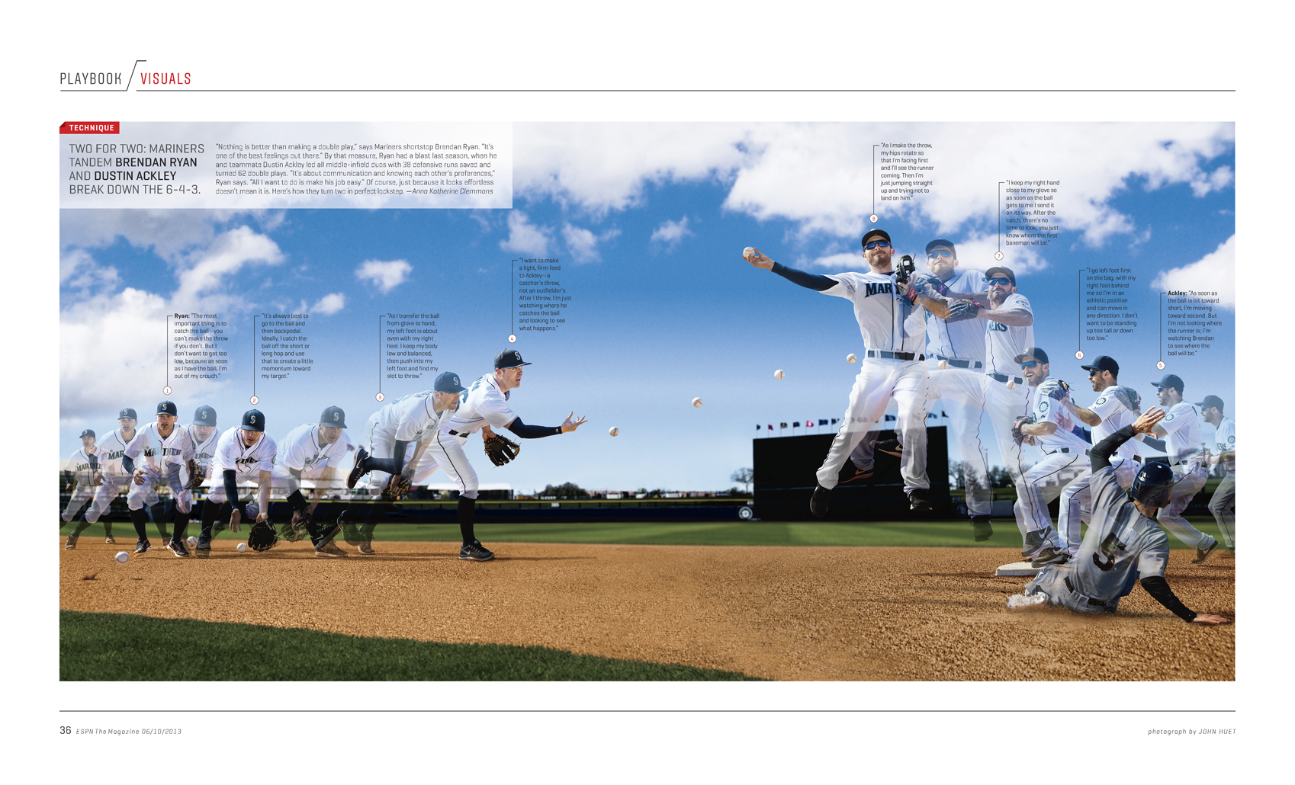
ESPN THE MAGAZINE

Slide 3
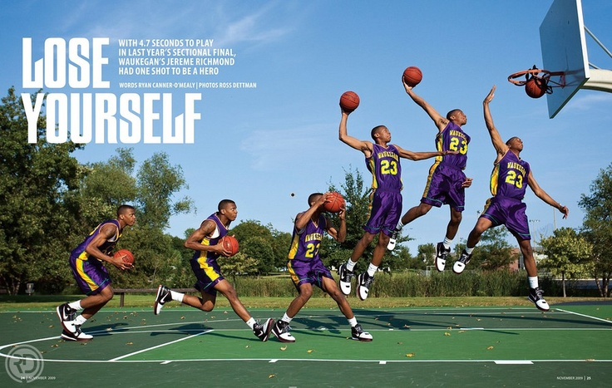
ESPN THE MAGAZINE

Slide 4
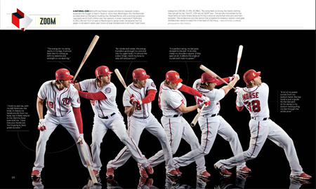
ESPN THE MAGAZINE

Slide 5
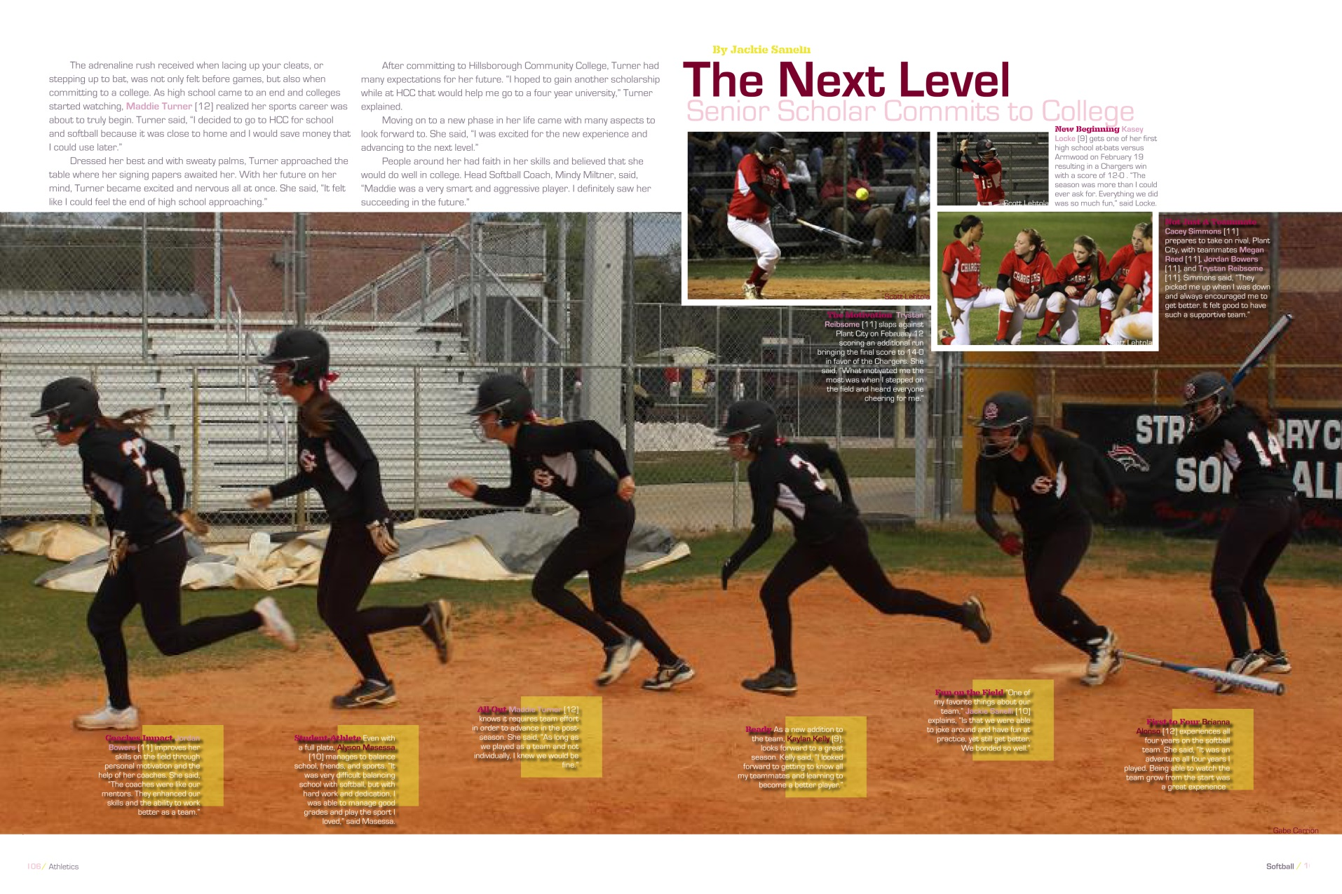
STRAWBERRY CREST 2013

Slide 6
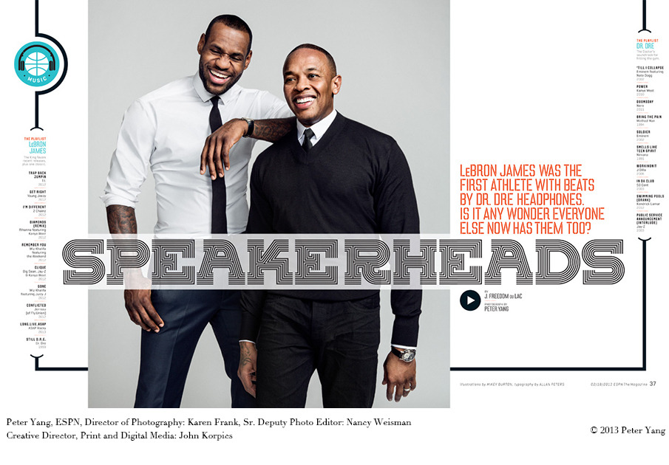
ESPN THE MAGAZINE

Slide 7
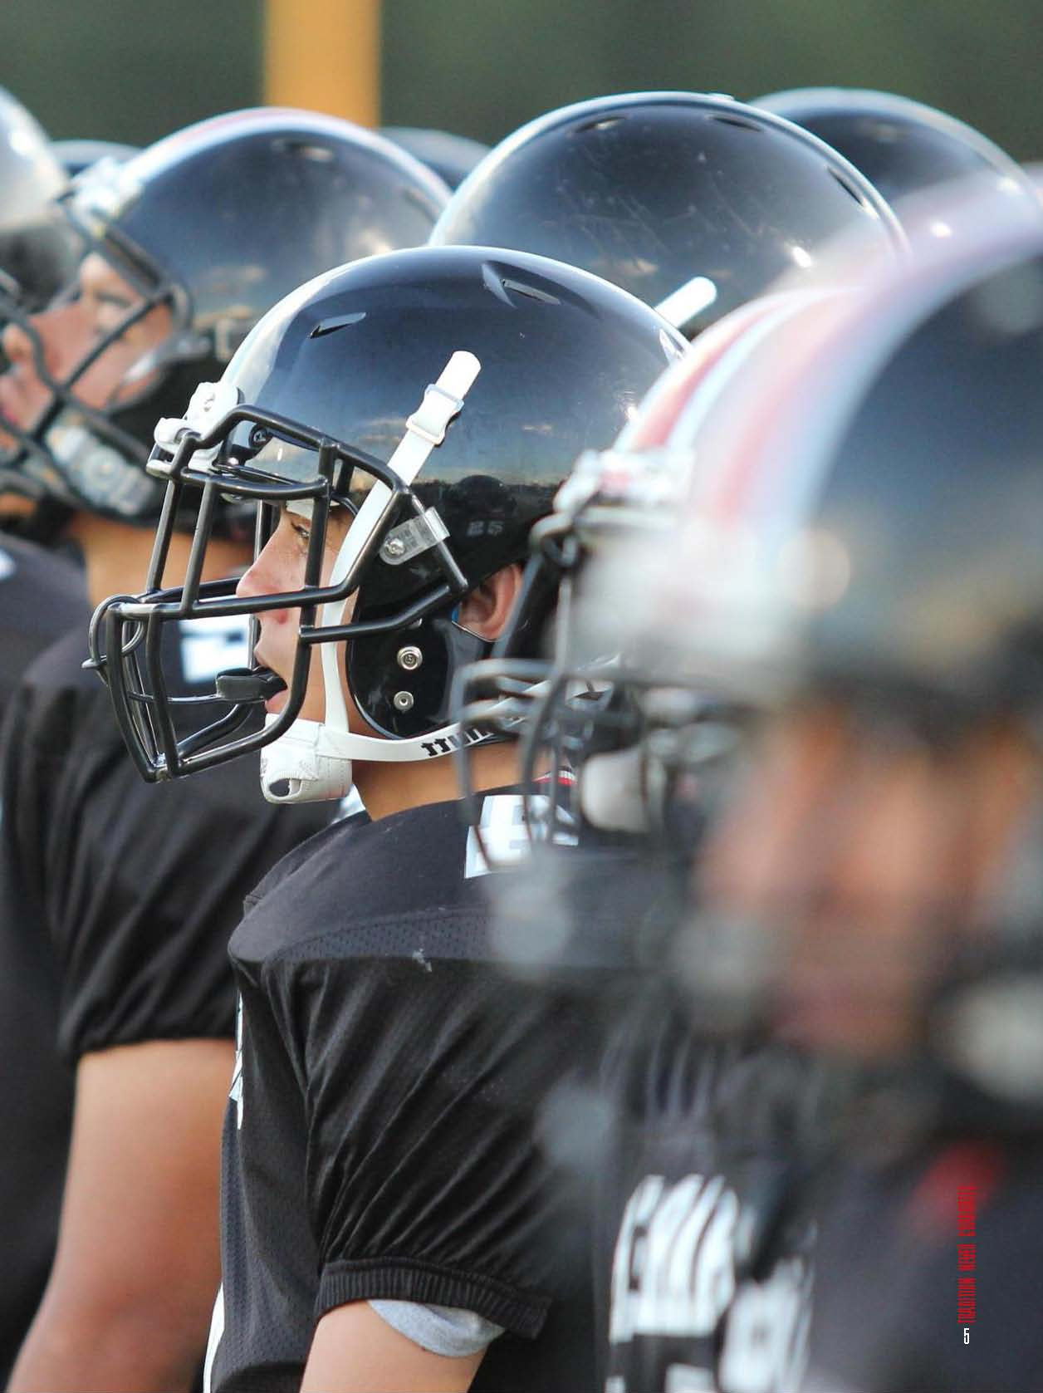
SC TITLE PAGES/OPENING/CLOSING SPREADS

Slide 8
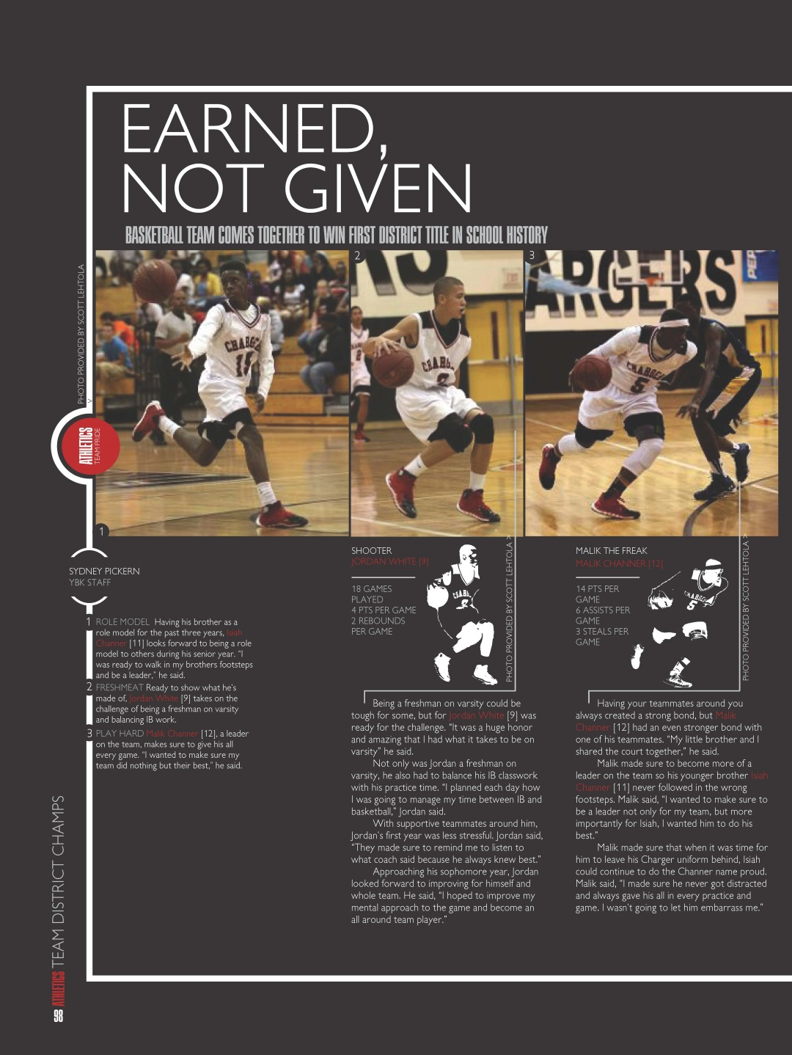
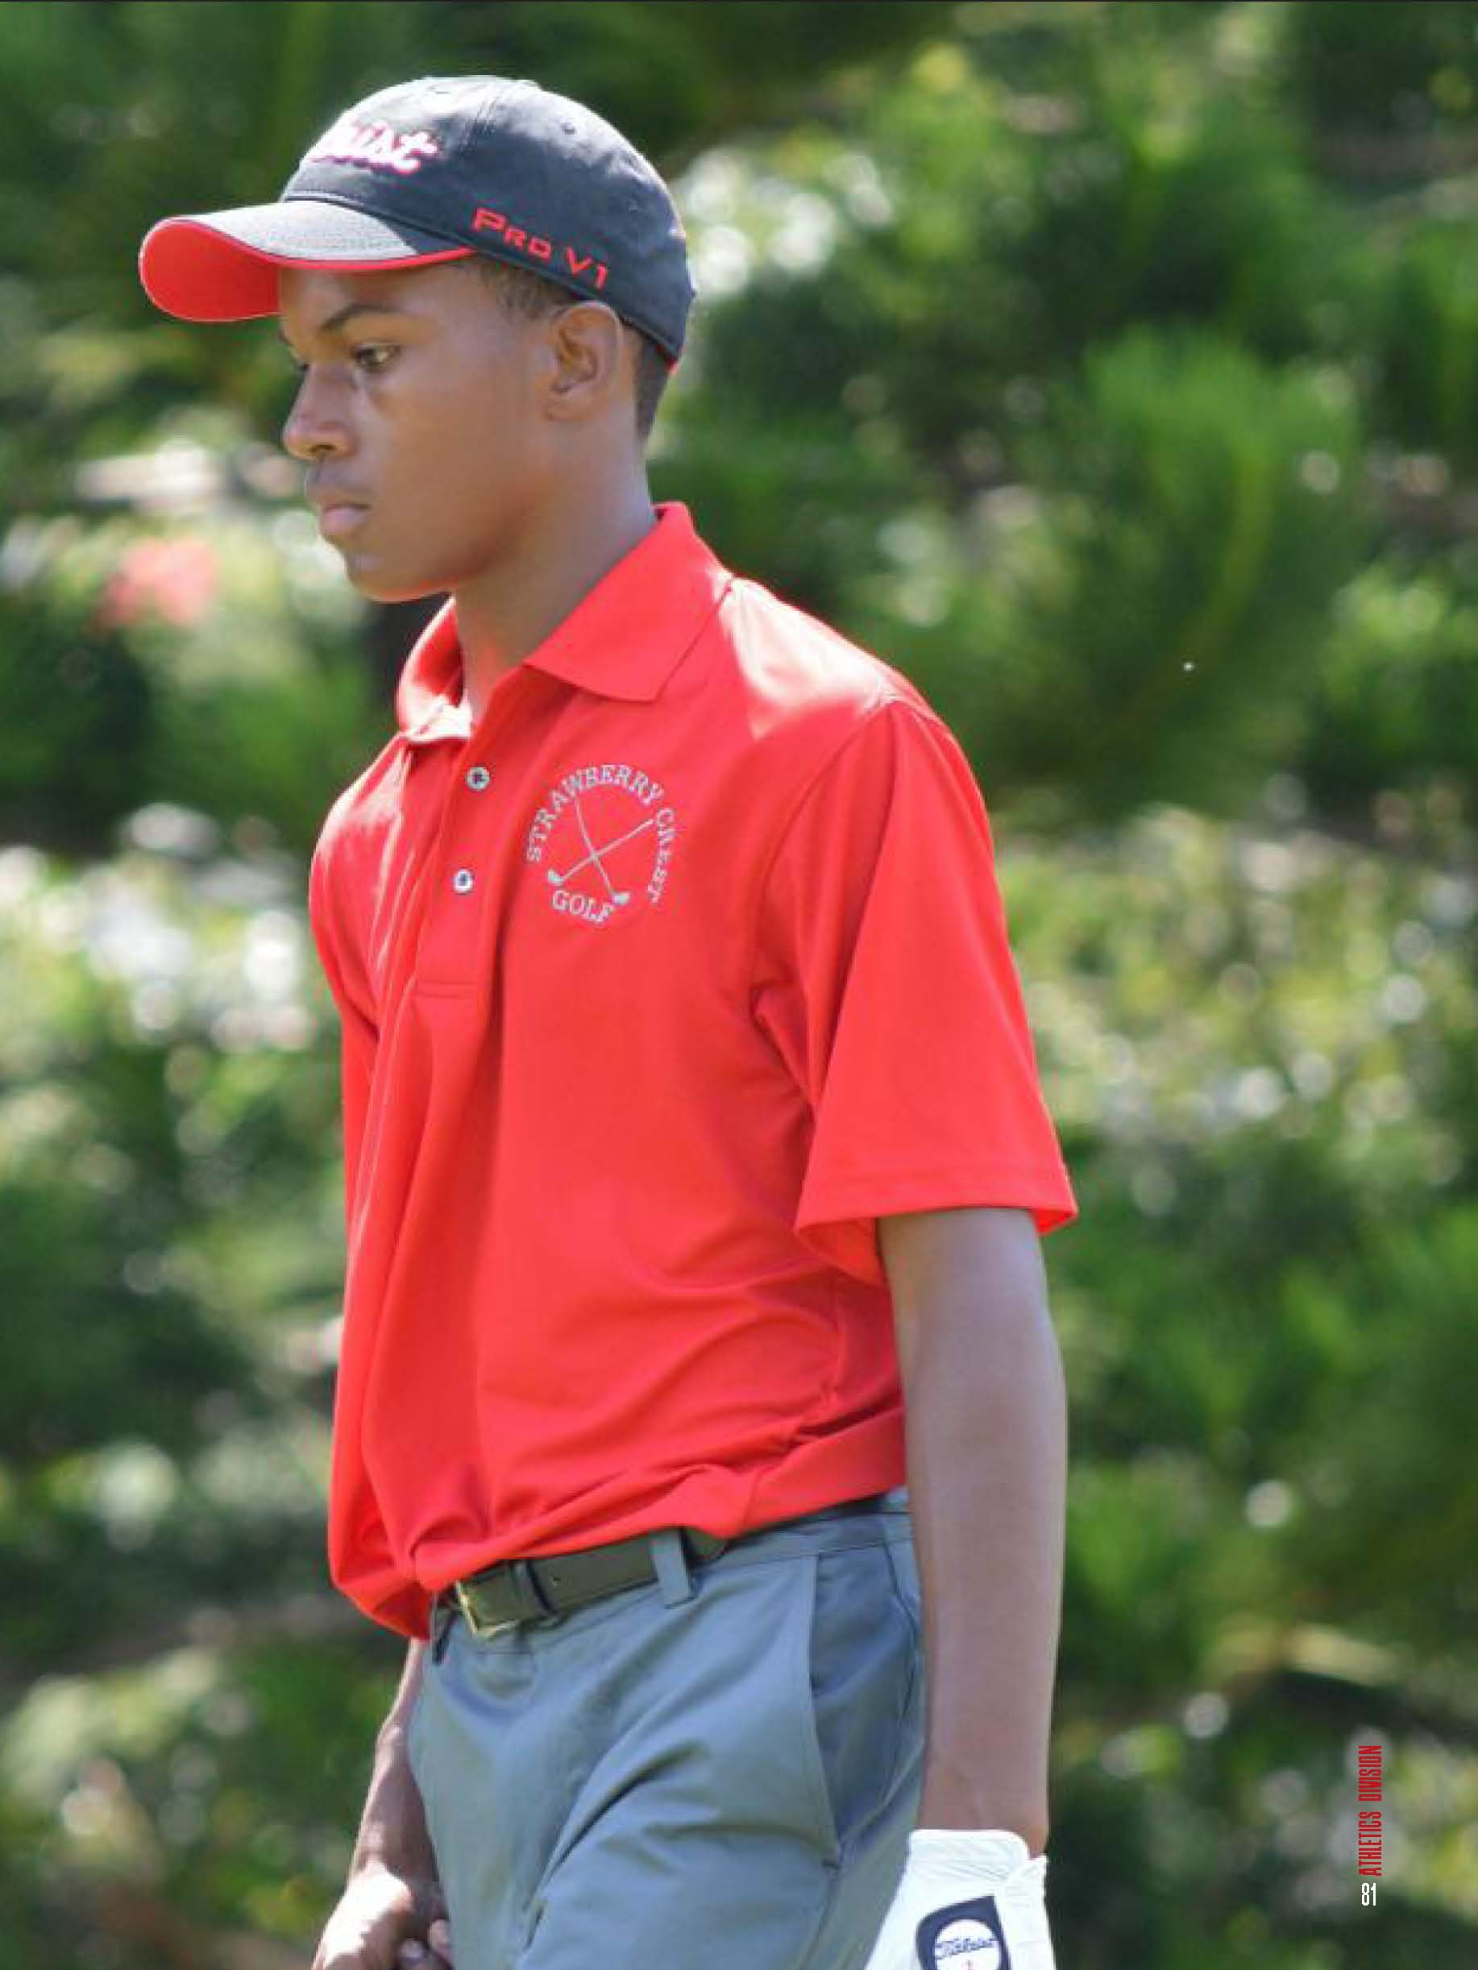
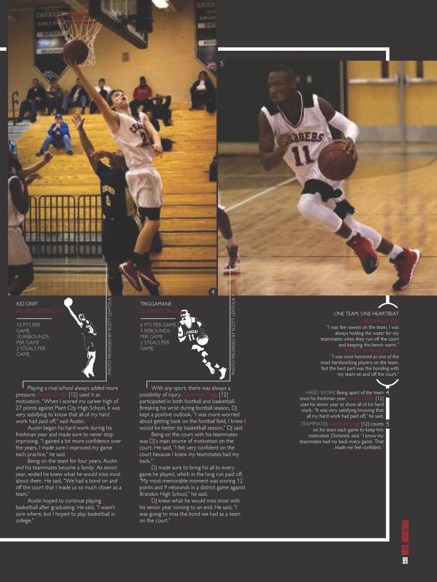
SC ATHLETICS SECTION ICONS

Slide 9
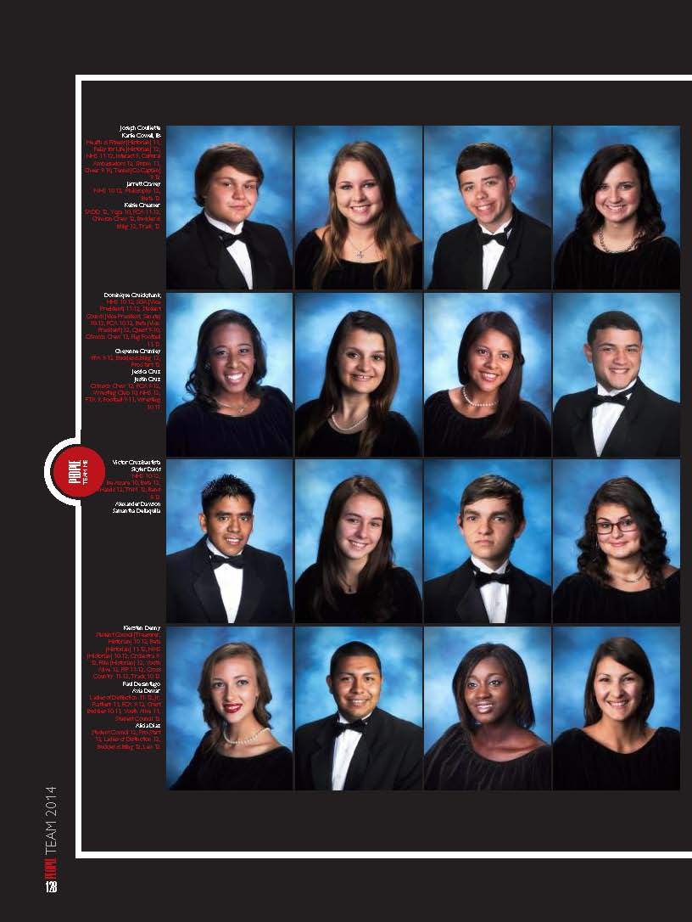
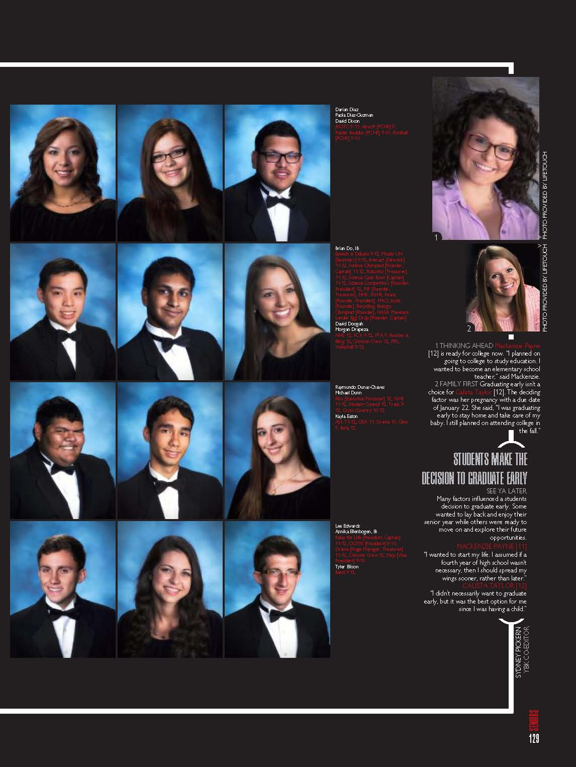
SC PEOPLE SECTION

Slide 10
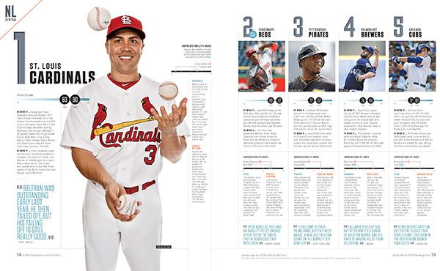
ESPN THE MAGAZINE

Slide 11
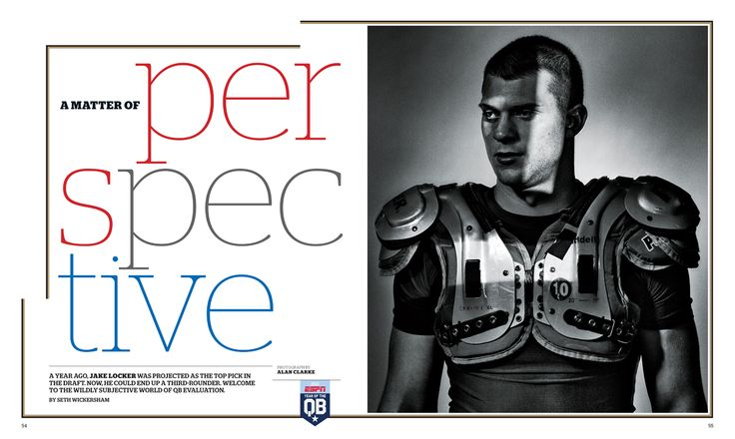
ESPN THE MAGAZINE

Slide 12
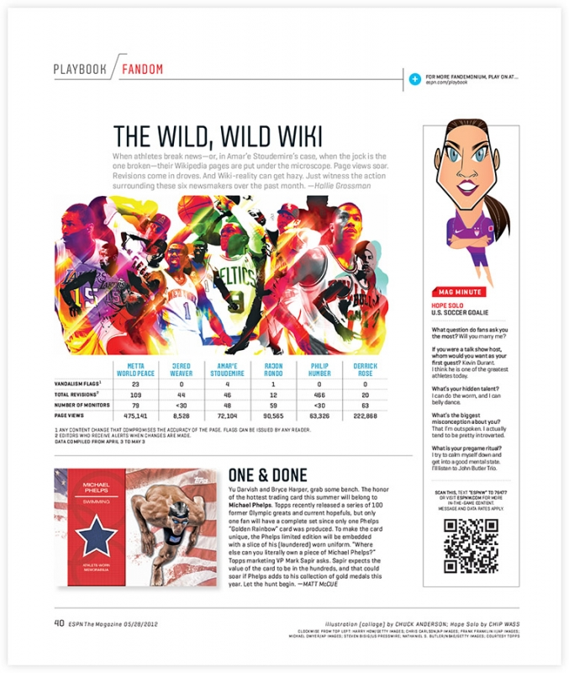
ESPN THE MAGAZINE

Slide 13
ESPN THE MAGAZINE

Slide 14
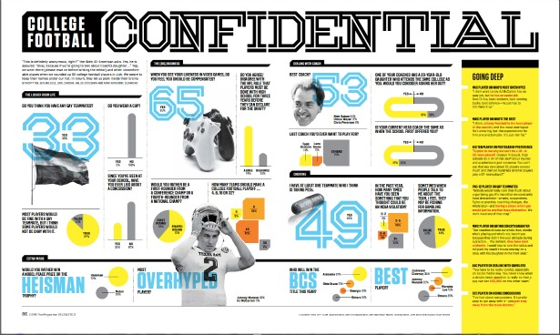
ESPN THE MAGAZINE

Slide 15
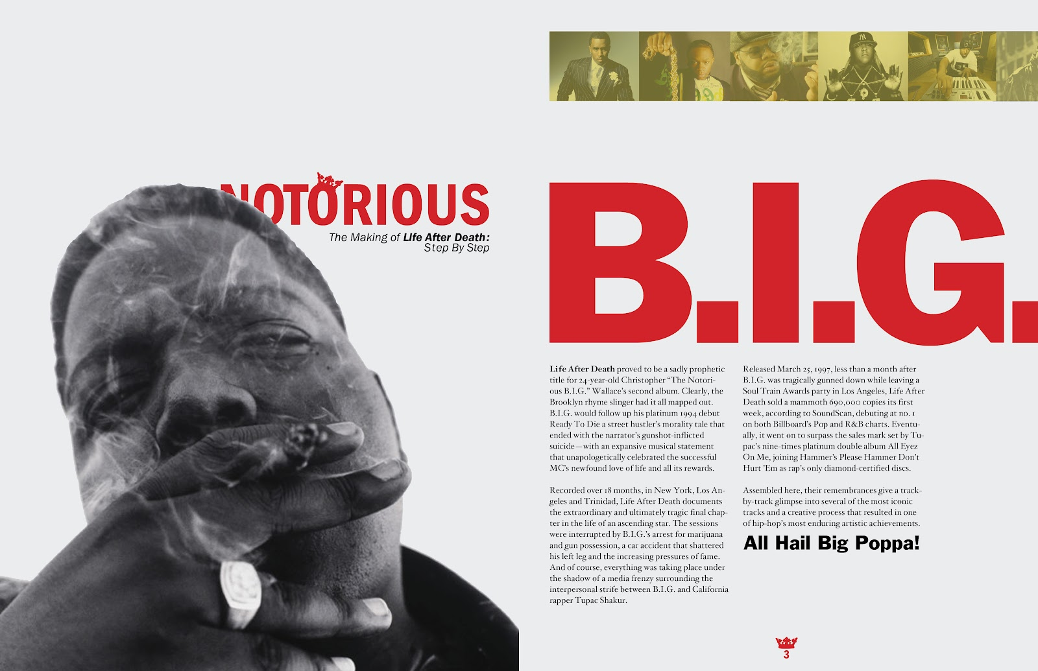
SAM SMALL

Slide 16
SAM SMALL

Slide 17
SAM SMALL

Slide 18
MOD DESIGN IDEAS | IMMERSE MAGAZINE

Slide 19
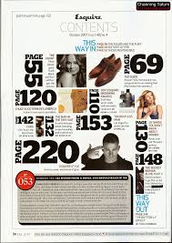
MOD DESIGN IDEAS
ESQUIRE MAGAZINE

Slide 20
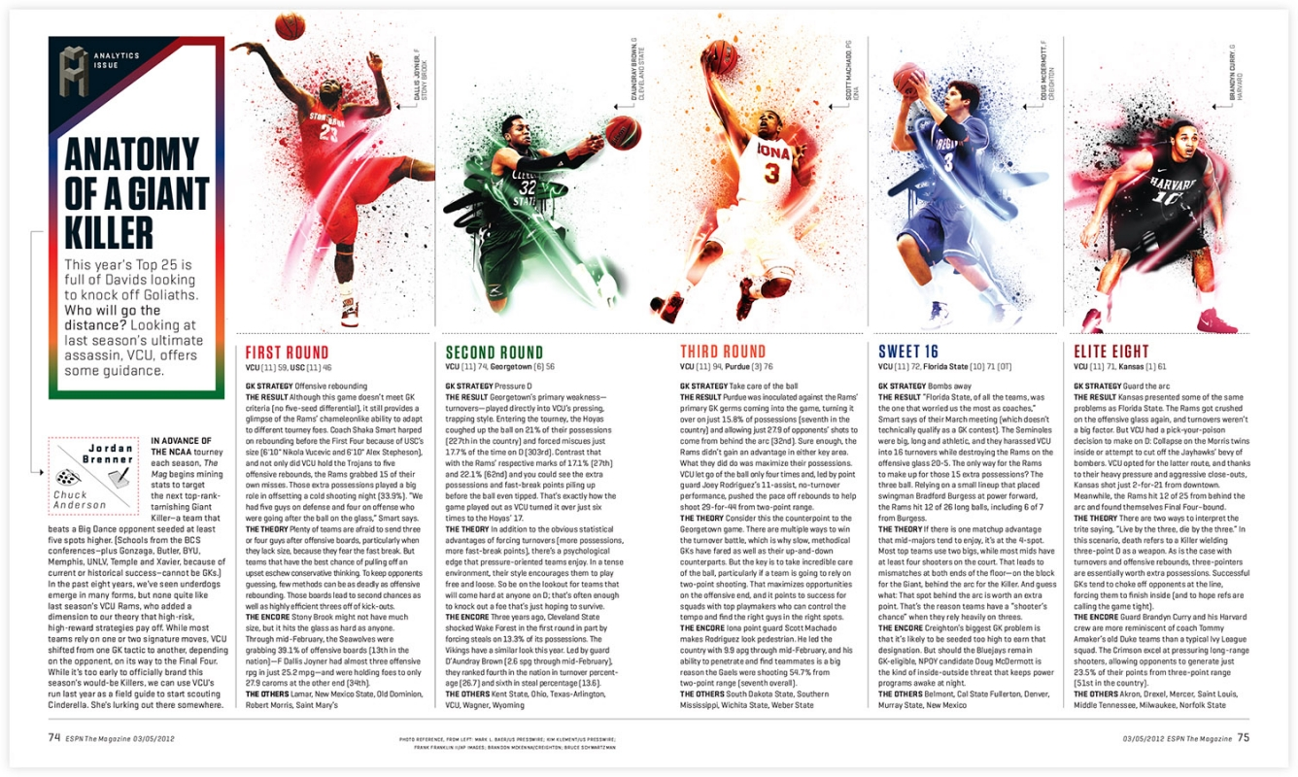
MOD DESIGN IDEAS | ESPN THE MAGAZINE

Slide 21
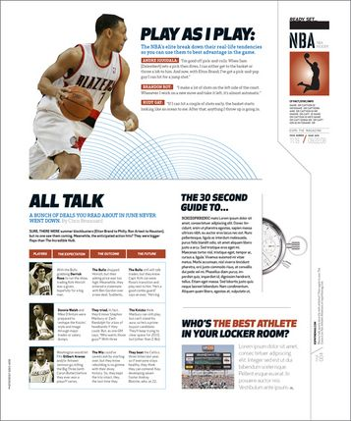
MOD DESIGN IDEAS
ESPN THE MAGAZINE

Slide 22
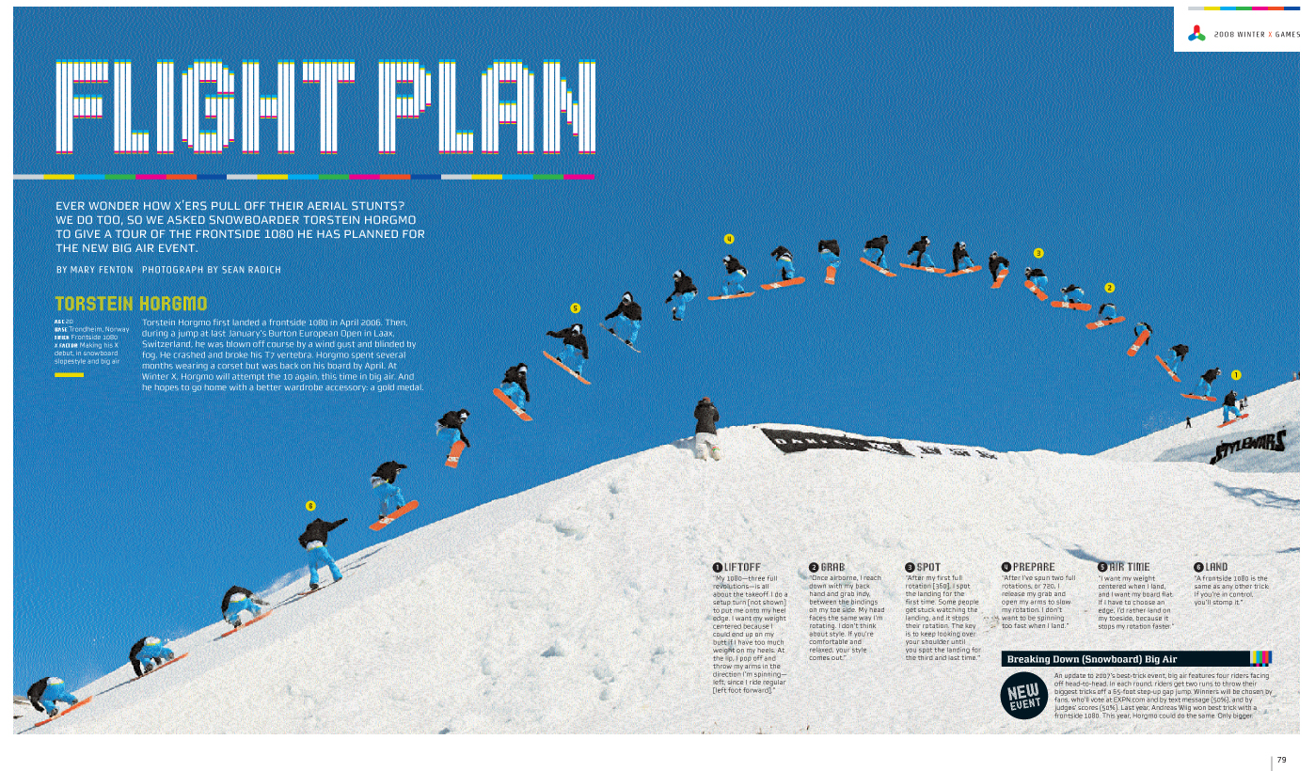
MOD DESIGN IDEAS | ESPN THE MAGAZINE

Slide 23
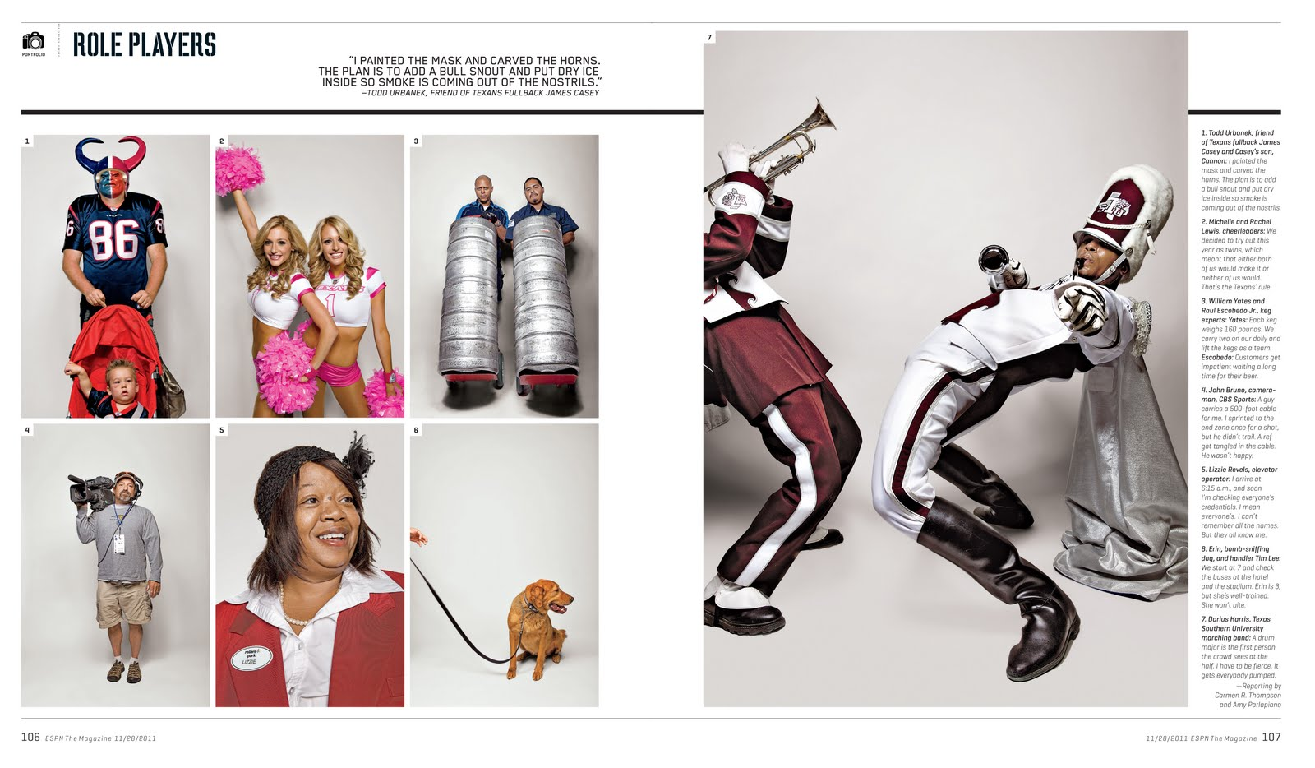
MOD DESIGN IDEAS | ESPN THE MAGAZINE

Slide 24
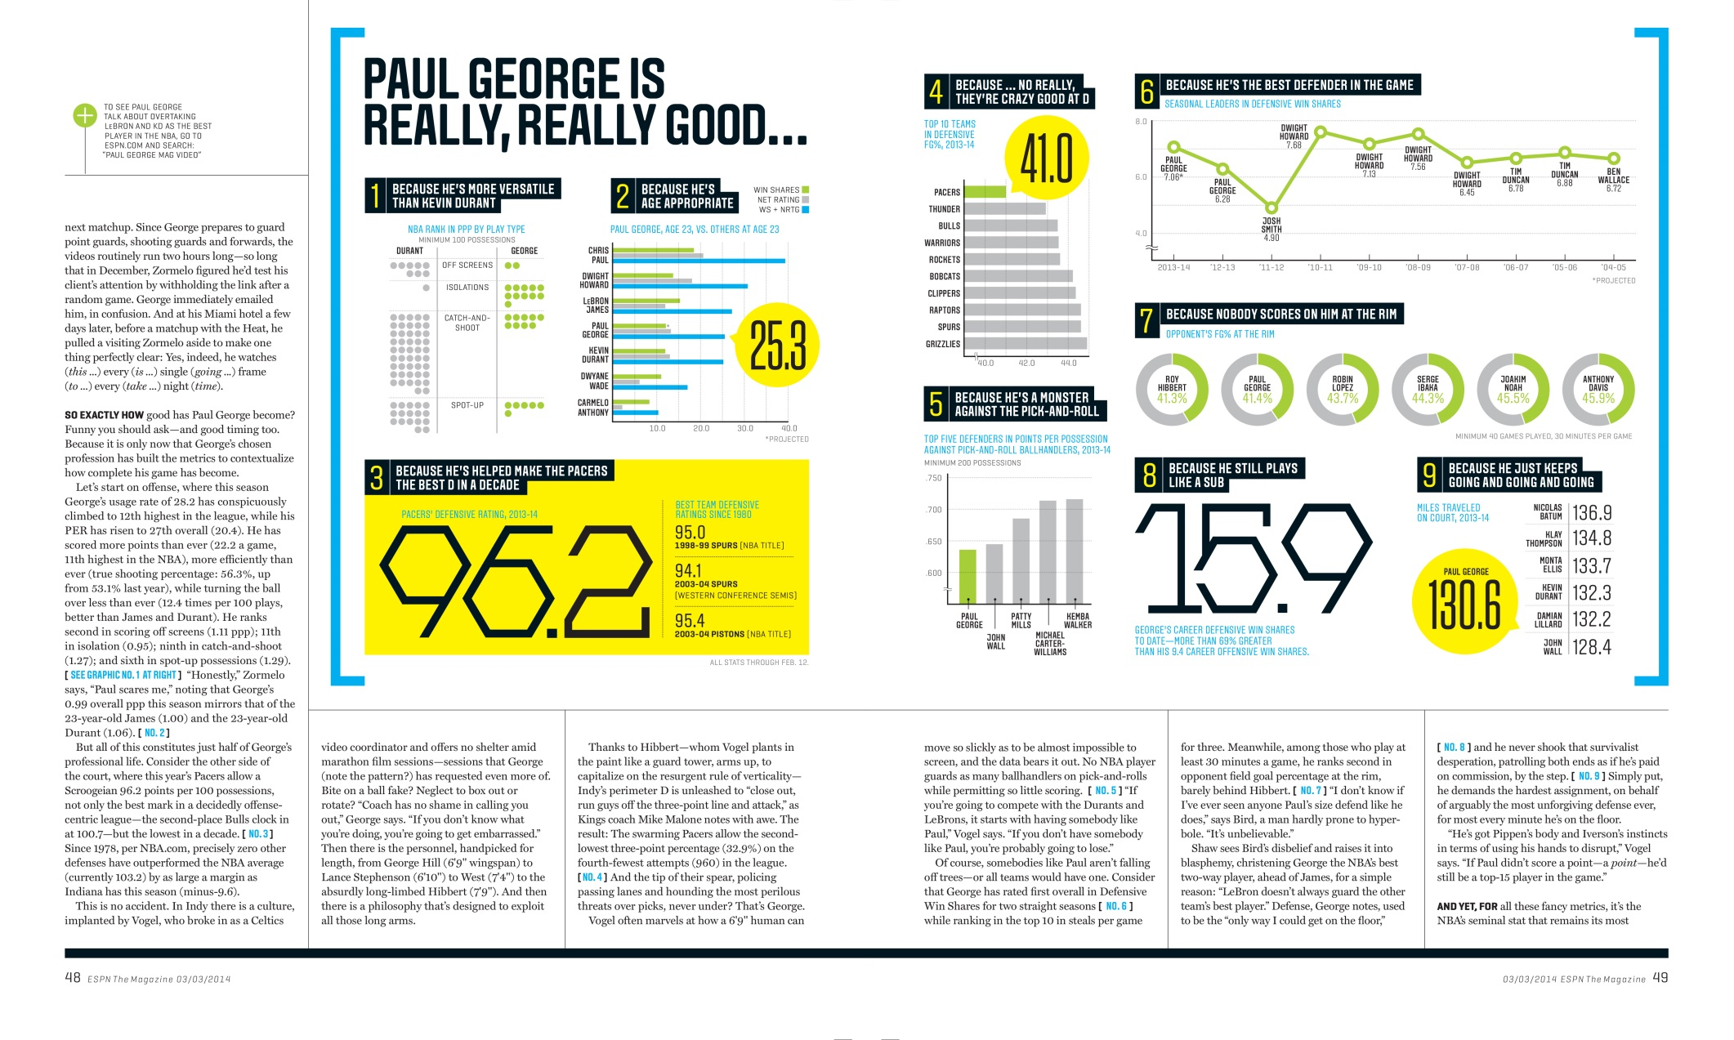
MOD DESIGN IDEAS | ESPN THE MAGAZINE

Slide 25
MOD DESIGN IDEAS | ESPN THE MAGAZINE

